Slide 1
Project Review AI POWERED CODE GENERATER
Team Members:
Agatheeswaran A (8208E22ASR008)
Haseeb Mohammed H (8208E22ASR022)
Praveenkumar S (8208E22ASR040)
Project coordinater:
Mr.R.Gopinath,
Assistan Professer

Slide 2
Problem Identified
Time-Consuming Code Writing:
Writing code from scratch can take a lot of time, especially for beginners or in large projects.
Lack of Expertise:
Non-technical users or those new to programming may struggle to write or debug code.
Syntax and Logical Errors:
Developers often face syntax errors or logical mistakes that can be time-consuming to identify and fix.
Inefficient Coding Practices:
Manual coding sometimes leads to redundant or inefficient code due to human error.
Limited Productivity:
Developers may spend excessive time on repetitive tasks, reducing innovation and productivity.

Slide 3
Key Business Objectives
Enhance Accessibility:
Enable beginners, non-programmers, and developers to write code effortlessly using natural language input.
Improve Developer Efficiency:
Reduce the time spent on repetitive coding tasks by automating code generation.
Minimize Errors:
Ensure accuracy in code by leveraging AI-powered validation and debugging.
Promote Innovation:
Allow developers to focus more on creative problem-solving and high-level design, rather than routine coding.

Slide 4
Base Paper Details
TITLE:AI-Assisted Code Generation
PUBLISHER:IEEE
AUTHORS:1. Simon Torkaa,
2. Sahin Albayrak.
PUBLISHED:14 DEC 2024

Slide 5
Literature Review
Advancements in AI Code Generation: The paper discusses the evolution of AI-assisted code generation tools such as ChatGPT, OpenAI Codex, GitHub Copilot, and AlphaCode.
Security and Reliability Concerns: The literature review emphasizes the necessity of addressing security vulnerabilities inherent in AI-generated code.
Functionality and Quality Optimization: The paper explores strategies to enhance the functionality and quality of AI-generated code.
Accessibility and Inclusivity: An important aspect covered in the literature review is the potential of AI-assisted code generation tools to democratize software development

Slide 6
Proposed Solution
Automate Code Generation – Reduce manual coding effort by generating functional code snippets.
Multi-Language Support – Support multiple programming languages (Python, C, C++, Java, JavaScript, etc.).
Context-Aware Code Suggestions – Provide syntactically and semantically correct code based on user input.
Improve Developer Productivity – Assist programmers in writing code faster with AI-generated suggestions.
Enhance Learning and Debugging – Help beginners and professionals by explaining generated code and suggesting improvements.

Slide 7
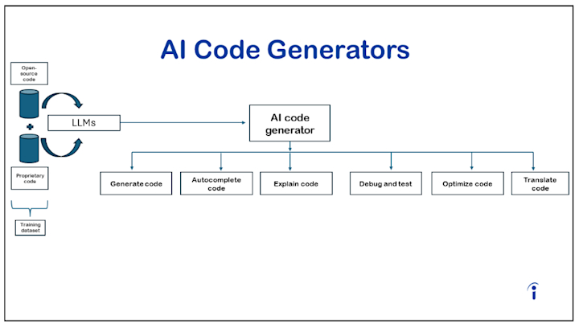

Slide 8
Implementation Details
1.Problem Definition
Identify the scope and purpose of your AI-powered code generator, such as translating natural language input into code snippets or automating repetitive coding tasks.
2. Data Collection
Gather datasets that contain annotated code examples and associated descriptions. For example:
Dataset libraries (e.g., CodeSearchNet).
Ensure diverse and high-quality examples to cover various coding scenarios.
3. Model Selection
Use pre-trained models like GPT, Codex, or other large language models specialized in code generation.
Choose frameworks for training (e.g., PyTorch, TensorFlow).
4. Preprocessing
Clean and preprocess the dataset:Normalize code syntax.Remove redundant or corrupted data.Tokenize both the natural language descriptions and code snippets.
Create pairs of input-output formats (description → code).
5. Model Training
Fine-tune the pre-trained model with your prepared dataset.
Define objectives, such as generating accurate and syntactically correct code.
6: Fine-Tuning & Optimization
Hyperparameter tuning (batch size, learning rate, dropout).
Train with a larger dataset for better generalization.
Apply Reinforcement Learning (RLHF) to improve user feedback-based ranking.

Slide 9
Model Performance
BLEU Score (Bilingual Evaluation Understudy)
Measures how similar the generated code is to human-written code.
Higher BLEU score = better code accuracy.
Example: BLEU score > 0.7 is considered good for code generation.
ROUGE Score (Recall-Oriented Understudy for Gisting Evaluation)
Evaluates how much overlap exists between generated code and reference code.
Higher ROUGE = better relevance.
Perplexity (PPL)
Measures how well the model predicts the next token in the code sequence.
Lower perplexity = better model performance.
Code-to-Code Similarity Score
Uses Levenshtein distance to compare generated code with actual human-written code.

Slide 10
Software Requirements
1. Operating System
Windows 10/11 (for local development)
Linux (Ubuntu 20.04/22.04, CentOS, Debian) (for server deployment)
macOS (M1/M2) (optional)
2. Programming Languages
Python 3.8+ (for AI model, backend development)
JavaScript (ES6+) (for frontend development)
3. AI/ML Frameworks
PyTorch or TensorFlow/Keras (for training the Transformer model)
Hugging Face Transformers (for fine-tuning pre-trained models like CodeT5, GPT)
Scikit-learn (for evaluation metrics like BLEU, ROUGE)

Slide 11
Possible Usage and Beneficiaries Industry
Software Development & Engineering
Automated Code Generation: Helps developers quickly generate boilerplate code.
Code Refactoring & Optimization: Suggests improvements for existing code.
Bug Detection & Fixing: Identifies and corrects common programming errors.
B. Education & Learning
Programming Assistance for Students: Acts as a coding tutor, explaining concepts.
Interactive Code Examples: Generates code snippets for learning purposes.
Code Debugging & Explanation: Helps students understand errors and solutions.
C. AI-Powered DevOps & Automation
Infrastructure as Code (IaC): Automates writing deployment scripts.
API Code Generation: Quickly generates REST API endpoints.
Database Query Automation: Converts natural language queries into SQL queries.

Slide 12
Conclusion / Future work
*The AI-powered code generator project marks a significant step toward automating code generation and simplifying software development processes.
*AI-powered code generator has successfully demonstrated its capability to understand natural language prompts and generate useful, contextually relevant code.

